Slide 1

Exploring the World of NodeJS

Slide 2
Introduction to NodeJS
1
What is NodeJS?
2
Why Choose NodeJS?
Open-source, server-side JavaScript
Built on top of the V8 JavaScript
Speed, efficiency, community
Great for web dev
Large volumes of traffic

Slide 3
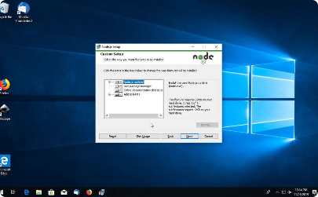
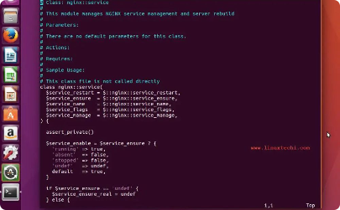
Getting Started with NodeJS
Installing NodeJS
Text Editors
- using package manager like NPM, which is included with NodeJS.
- VS code (great plugins)
- Sublime Text

Slide 4
Key Features of NodeJS
Event-Driven Architecture
Non-Blocking I/O Model
- better memory optimized and more efficient management of high volume web traffic.
- requests do not get blocked by other requests
Package Ecosystem
Asynchronous Programming Model
- over 800,000 packages available on NPM
- uses an asynchronous programming model

Slide 5

Building Web Applications using NodeJS
1
Developing the Backend
- creating RESTful API endpoints connecting to a database (e.g., MongoDB, PostgreSQL) and building server-side logic.
2
Developing the Frontend
- web technologies like HTML, CSS, JavaScript, React ...
3
Integrating the Frontend and Backend
- using Express

Slide 6
Conclusion and Future of NodeJS
Benefits of NodeJS
The Future of NodeJS
Increased resilience
Bright
Used very often and continues to expant
Improved performance
Broad appeal
Great for efficient, scalable and high-performance web applications

